Slide 1
DOM
Ivaniuk Oleh
11.2019

Slide 2
Agenda
DOM
Main concept
DOM methods and properties
Element search methods
DOM navigation
document.body
ChildNodes, children properties
Node object
parentNode, previousSibling, nextSibling properties
navigation in tables and forms
DOM Nodes
Nodes properties
Creating, inserting, deleting nodes

Slide 3
DOM

Slide 4
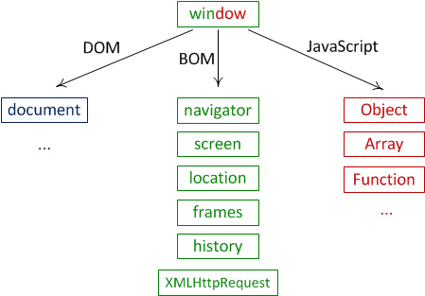
Main concept
One of the key tasks of JavaScript is user interaction and manipulation of web page elements. For JavaScript, a web page is available as a document object model or DOM for short.
The DOM describes the structure of a web page in a tree view and provides developers with a way to access and modify individual elements of a web page.
When a web page is loaded, the browser creates a Document Object Model of the page.
The browser gives access to the hierarchy of objects that we can use for development. The figure shows the structure of the main browser objects. At the top is a window, which is also called a global object.
Document Object Model (DOM). Available through document. Gives access to the contents of the page.
Browser Object Model (BOM). BOMs are objects for working with anything but a document.
JavaScript objects and functions. Javascript is the linking language of all this.

Slide 5
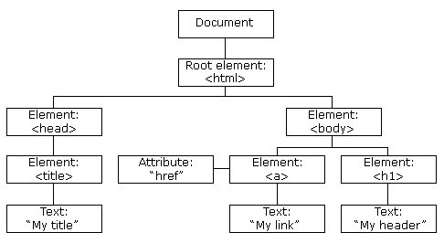
DOM tree
The DOM represents a document as a tree. The tree is made up of parent-child relationships, a parent can have one or many children nodes.
<html>
<head>
<title>My title</title>
</head>
<body>
<h1>My header</h1>
<a href="#">My link</a>
</body>
</html>
Element node
Text node
Thus, all components are ordered in a DOM in a hierarchical manner, where each component represents a separate node. That is, each element, for example, element h1, is a node. But also the text inside the element represents a separate node.
Notes:
Загалом існує більше 10 типів вузлів, але ми будемо працювати лише з деякими з них.

Slide 6
DOM methods and properties
DOM methods are actions you can perform (on HTML Elements).
DOM properties are values (of HTML Elements) that you can set or change.
Using DOM methods and properties, a user can:
Modify HTML elements on the page
Modify attributes
Change CSS styles
Delete existing HTML elements and attributes
Add new HTML elements and attributes
Respond to user actions against HTML elements
Create new events

Slide 7
Element search methods
The following methods are used to search for HTML elements on a page:
document.getElementById(value): selects an element whose id attribute is value
document. getElementsByTagName(value): selects all elements for which the tag is equal to value
document. getElementsByClassName(value): selects all elements that have the value class
document. querySelector(value): selects the first element that matches the value css selector
document. querySelectorAll(value): selects all elements that match the value css selector
!
The querySelectorAll() method does not work in Internet Explorer 8 and earlier versions.

Slide 8
Element search methods
<body>
<div class=”test2”></div>
<p id="test" class="test2"></p>
<p class=”test2”></p>
<p></p>
<input type="text" />
<input type="radio" />
<script>
let id = document.getElementById("test");
let class = document.getElementsByClassName("test2");
let tag = document.getElementsByTagName("p");
let x = document.querySelectorAll("div.test2");
let y = document.querySelector("p.test2“);
</script>
</body>

Slide 9
DOM
navigation

Slide 10
DOM navigation. Object Document
The document object is the main "entry point" in the DOM. From it we can access any node.
document allows you to access frequently used elements of a web page through the properties:
document.documentElement: provides access to the root <html> element
document.body: provides access to the <body> element in a web page
document.images: contains a collection of all image objects (img elements)
document.links: contains a collection of links - elements <a> and <area> that have the href attribute defined
document.anchors: provides access to a collection of <a> elements that have a name attribute defined
document.forms: contains a collection of all forms on a web page

Slide 11
DOM navigation. document.body
There is one subtlety: document.body can be null. In particular, if the script is located in <head>, document.body is not available in it, because the browser has not yet read it. You cannot access an element that does not exist at the time the script is executed. The first alert will print null:
<head>
<script>
alert("document.body from HEAD: " + document.body); // null
</script>
</head>
<body>
<script>
alert("document.body from BODY: " + document.body);
</script>
</body>
!
In the DOM, null means "does not exist" or "there is no such node."

Slide 12
DOM navigation. Node object
Each individual node, whether it is an html element, its attribute or text, in the DOM structure is represented by a Node object. This object provides a number of properties with which we can obtain information about this node:
childNodes: contains a collection of child nodes
firstChild: returns the first child node of the current node
lastChild: returns the last child node of the current node
previousSibling: returns the previous item that is on par with the current
nextSibling: returns the next element that is flush with the current
ownerDocument: returns the root node of the document
parentNode: returns the element that contains the current node
nodeName: returns node name
nodeType: returns node type as a number
nodeValue: returns or sets the value of the node in plain text

Slide 13
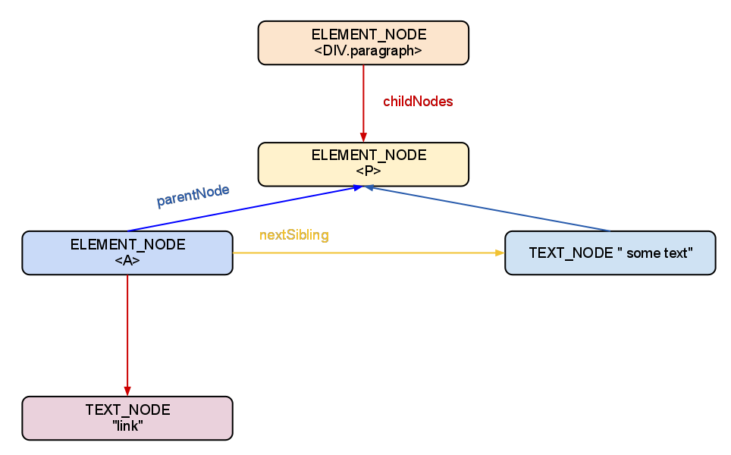
DOM navigation. ChildNodes property
From the parent node, all children can be retrieved. There are several ways to do this. The "childNodes" property holds all child elements, including text ones. We will consistently display all the child nodes of "document.body":
<body>
<div>
<p>
<a>link</a> some text
</p>
</div>
<script>
let bodyNodes = document.body.childNodes;
for (let i = 0; i < bodyNodes.length; i++) {
alert(bodyNodes[i]); // Text DIV Text SCRIPT
}
</script>
</body>

Slide 14
DOM navigation. Children property
The "children" property lists only child element nodes (that is, tags, text, and others are missing). We will subsequently display all the document.body child nodes:
<body>
<div>
<p>
<a>link</a> some text
</p>
</div>
<!-- Comment -->
<script>
let bodyElements = document.body.children;
for (let i = 0; i < bodyElements.length; i++) {
alert(bodyElements[i]); // DIV SCRIPT
}
</script>
</body>

Slide 15
DOM navigation. Node object
You can use the firstChild and lastChild properties of the DOM node to access the first and last direct child node of a node, respectively. If the node doesn't have any child element, it returns null.
firstChild
BODY
lastChild
<body>
<h1>Some header</h1>
<p>Some text</p>
<a>Some link</a>
</body>
H1
P
A
The "firstChild" and "lastChild" properties are a faster and shorter way to access the first and last elements of "childNodes"
The equalities are true:
body.firstChild === body.childNodes[0]
body.lastChild === body.childNodes[body.childNodes.length-1]

Slide 16
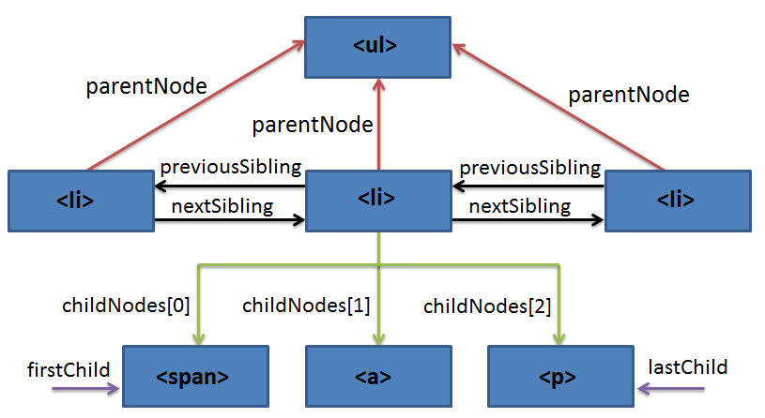
DOM navigation. ParentNode, previousSibling, nextSibling properties
Property "parentNode" refers to the parent node
The "previousSibling" and "nextSibling" properties give access to the left and right neighbors:
<ul>
<li id="liElem">node</li>
<li><span>node</span><a href="#">node</a><p>node</p></li>
<li>node</li>
</ul>

Slide 17
DOM navigation. Tables
Tables have additional properties for more convenient navigation:
caption/tHead/tFoot - links to table elements CAPTION, THEAD, TFOOT
tBodies - a list of elements of the TBODY table, according to the specification there may be several
rows - a list of TR lines of the table/section THEAD/FFOOT/TBODY
cells - list of TD/TH cells
sectionRowIndex - line number in the current section THEAD/TBODY
rowIndex - row number in the table
cellIndex - cell number in a row
<body>
<table>
<tr><td>Monday</td><td>Tuesday</td></tr>
<tr><td>Wednesday</td><td>Thursday</td></tr>
</table>
<script>
let elem = document.body.children[0];
alert(elem.rows[0].cells[0].innerHTML);
</script>
</body>
// "Monday"

Slide 18
DOM navigation. Forms
One of the ways to interact with users is html forms. To get the form, we can use both the serial number in the document and its name document.forms[index/name].
document.forms[0] - first form in a document
document.forms.registerForm - name form “registerForm" (name="registerForm")
When we have already received the form, any item is available in the named collection. form.elements.
<body>
<form name="registerForm">
<input name="surname" value="1" />
<input name="email" value="2" />
</form>
<script>
let myForm = document.forms.registerForm;
let elem = myForm.elements.surname;
alert(elem.value); // 1
</script>
</body>
form
elements
form
form
elements[0]
…
elements[n]
There may be several items with the same name. In this case, the "elements" property will return an array of elements

Slide 19
DOM navigation. Additional navigation properties
All modern browsers, including IE9 +, support sitelinks:
firstElementChild – first child element (=children[0])
lastElementChild – last child element (=children[children.length-1])
childElementCount – number of child elements (=children.length)
nextElementSibling – right sibling
previousElementSibling – left sibling
Any nodes other than elements are simply ignored:
<body>
firstElementChild: <p>Some paragraph</p>
<!-- Comment -->
lastElementChild: <div>Some DIV</div>
<script>
alert(document.body.firstElementChild.nextElementSibling); // DIV
</script>
</body>

Slide 20
DOM
Nodes

Slide 21
Nodes properties. InnerHTML
The innerHTML property allows you to get the HTML content of an element as a string.
We can also change it. This is one of the most powerful ways to change the content on a page.
<body> <h1 id="header">I’am header</h1> <script> document.getElementById("header").innerHTML = "New header"; </script> </body>

Slide 22
Nodes properties. InnerHTML
Through innerHTML we can add not only text, but also other tags. When recording, you can record anything, and if we make a mistake, the browser will correct the incorrect HTML code:
<body> <script> document.body.innerHTML = '<b>Text message </b> '; // forgot to close the tag
alert( document.body.innerHTML ); // <b>Text message</b> (fixed) </script> </body>
!
If innerHTML inserts a <script> tag into the document, it becomes part of the HTML, but does not start.

Slide 23
Nodes properties. OuterHTML
outerHTML property holds the whole HTML Node.
You can assign to some variable HTLM Node with outerHTML, but, if you assign to this variable some text that can be interpreted as HTML document, it will be separate node and origin document will not be changed.
<body>
<div id="hi">Hello <b>World</b></div>
<script>
let d = document.body.children[0];
alert(d.outerHTML); // <div id="hi">Hello <b>World</b></div>
d.outerHTML = "<p>New HTML!</p>";
alert(d.tagName); // DIV
alert(d.innerHTML); // Hello <b>World</b </b>
</script>
</body>

Slide 24
Nodes properties. NodeType
The nodeType property is read only. It returns the type of a node.
The most important nodeType properties are:
Node type | Type | Example
ELEMENT_NODE | 1 | <p id="main">Main paragraph</p>
ATTRIBUTE_NODE | 2 | id = "main" (deprecated)
TEXT_NODE | 3 | Main paragraph
COMMENT_NODE | 8 | <!-- Some comment -->
DOCUMENT_NODE | 9 | The HTML document itself (the parent of <html>)
DOCUMENT_TYPE_NODE | 10 | <!Doctype html>
<div id="first">Main block here</div> <div id="second"></div> <script> document.getElementById("second").innerHTML = document.getElementById("first").nodeType; </script>

Slide 25
Nodes properties. nodeName, tagName
There are two properties: "nodeName" and "tagName", which contain the name (tag) of the node element. The name of the HTML tag is always uppercase. For "document.body":
alert(document.body.nodeName); // BODY
alert(document.body.tagName); // BODY
The difference is reflected in the property names, but not obvious:
- the "nodeName" property - defined for many types of DOM nodes
- the tagName property - only elements have it
With the help of "tagName" they work only with elements, and "nodeName" with all types of nodes:
<body><!-- Comment-->
<script>
// for comment
alert(document.body.firstChild.nodeName); // #comment
alert(document.body.firstChild.tagName); // undefined
// for a document
alert(document.nodeName); // #document
alert(document.tagName); // undefined , because DOM root is not an element
</script>
</body>

Slide 26
Nodes properties. Other useful properties
DOM nodes have type-specific properties, for example:
- value - value for "input", "select" or "textarea“
- id – identifier
- className - class
- href - link address
- a lot others
<body>
<input type="text" id="my-input" class="my-class" value="my-value" />
<script>
let myInput = document.getElementById("my-input");
alert(myInput.type); // text
alert(myInput.id); // my-input
alert(myInput.className) // my-class
alert(myInput.value); // "my-value"
</script>
</body>

Slide 27
Creating nodes. createElement, createTextNode
A DOM node can be created using two methods:
1) document.createElement(tag) - creates a new element with the given tag tag
2) document.createTextNode(text) - creates a new text node with the given text text
let newHeader = document.createElement("h1");
let newText = document.createTextNode("New text message!");
We can assign properties for new element:
let newHeader = document.createElement("h1");
newHeader.className = "newClass";
newHeader.id = "newId";
newHeader.innerHTML = "I header!";

Slide 28
Cloning nodes. cloneNode
Sometimes elements are quite complex in composition, and it is much easier to clone them than using separate calls to create from the content.
elem.cloneNode(true) - creates a "deep" clone of the element, with all attributes and child elements
elem.cloneNode(false) - creates a clone without children.
<div>
<span>Big text here!</span>
</div>
<script>
let spanElem = document.getElementsByTagName("span")[0];
let newSpan = spanElem.cloneNode(true); // clone node
console.log(newSpan.innerHTML); // Big text here!
newSpan.innerHTML = "Another text here!";
console.log(newSpan.innerHTML); // Another text here!
</script>

Slide 29
Nodes. Insertion methods
Creating elements is not enough; you still need to add them to the web page.
This set of methods provides more ways to insert:
node.append(...nodes or strings) – append nodes or strings at the end of node
node.prepend(...nodes or strings) – insert nodes or strings at the beginning of node
node.before(...nodes or strings) –- insert nodes or strings before node
node.after(...nodes or strings) –- insert nodes or strings after node
node.replaceWith(...nodes or strings) –- replaces node with the given nodes or strings.
There are several other, older, insertion methods:
parentElem.appendChild(node) - appends node as the last child of parentElem.
parentElem.insertBefore(node, nextSibling) - inserts node before nextSibling into parentElem

Slide 30
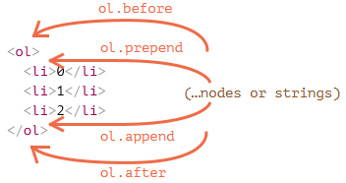
Nodes. Insertion methods
<ol id="ol">
<li>0</li>
<li>1</li>
<li>2</li>
</ol>
<script>
ol.before('before'); // insert the string "before" before <ol>
ol.after('after'); // insert the string "after" after <ol>
let liFirst = document.createElement('li');
liFirst.innerHTML = 'prepend';
ol.prepend(liFirst); // insert liFirst at the beginning of <ol>
let liLast = document.createElement('li');
liLast.innerHTML = 'append';
ol.append(liLast); // insert liLast at the end of the <ol>
</script>

Slide 31
Nodes. Insertion methods. insertAdjacentHTML()
The insertAdjacentHTML() method inserts a text as HTML, into a specified position.
elem.insertAdjacentHTML(where, html)
The first parameter is a special word indicating where to insert with respect to elem. The value must be one of the following :
"afterbegin" - after the beginning of the element (as the first child) "afterend" - after the element "beforebegin" - before the element "beforeend" - before the end of the element (as the last child)
The second parameter is the HTML string that will be inserted exactly as HTML.
<div id="div"></div>
<script>
div.insertAdjacentHTML('beforebegin', '<p>Hi</p>');
div.insertAdjacentHTML('afterend', '<p>By</p>');
</script>
<p>Hi</p>
<div id="div"></div>
<p>By</p>

Slide 32
Node Attributes
DOM nodes provide access to the attributes of HTML elements. Attributes are accessed using standard methods:
hasAttribute(name) – checks for an attribute
getAttribute(name) – gets attribute value
setAttribute(name, value) – sets attribute
removeAttribute(name) – removes attribute
Unlike properties, attributes:
- Can only be strings.
- Their name is case insensitive (because this is HTML)
- Visible in "innerHTML" (except for older IE)
- All attributes of an element can be obtained using the "attributes" property
<p id="item" info="JavaScript">Some text</p>
<script>
alert(item.getAttribute('info') ); // (1) 'JavaScript', reading
item.setAttribute('Example', 111); // (2), writing
alert(item.outerHTML ); // (3), check if there is an attribute in HTML (yes)
</script>

Slide 33
Removing and replacing nodes
There are a number of methods for removing and replacing nodes :
node.remove() – removes the node from the DOM tree
parentElem.removeChild(elem) – removes "elem" from the list of children "parentElem"
parentElem.replaceChild(elem, currentElem) – among children, "parentElem" replaces "currentElem" with "elem"
<div id="box">
<div id="one">1</div>
<div id="two">2</div>
<div id="three">3</div>
</div>
<script>
let elem = document.querySelector("#one");
elem.remove();
alert(document.querySelector("#box").innerHTML); // #One block disappeared
let parent = document.querySelector("#box");
let child = document.querySelector("#three");
parent.removeChild(child);
alert(document.querySelector("#box").innerHTML); // #Three block disappeared
</script>

Slide 34
Change element style
There are mainly two approaches used to work with the style properties of elements in JavaScript:
1) Change the style property
2) Changing the value of the class attribute
1) The style property represents a complex object for controlling the style and is directly mapped to the style attribute of the html element. This object contains a set of CSS properties: element.style.CSS_property.
elem.style.width="200px" style="width:200px"
However, a number of css properties in the names have a hyphen, for example, font-size. JavaScript does not use a hyphen for these properties, but camelCase is used.
let root = document.documentElement;
root.style.fontSize = "14px";
!
You must specify the units in style, as in CSS, just root.style.fontSize = 14 - it won’t work

Slide 35
Change element style
2) Using the className property, you can set the class attribute of the html element.
<body class="main page">
<script>
alert(document.body.className); // main page
</script>
</body>
If we assign something to elem.className, then this replaces the entire line with the classes. Sometimes this is what we need, but often we want to add / remove one class.
There is another property for this: elem.classList.
This property represents an object that implements the following methods:
elem.classList.add/remove("class") – add / remove class.
elem.classList.toggle("class") – add a class, if not, otherwise delete.
elem.classList.contains("class") – checking for a class, returns true / false.
let articleDiv = document.querySelector("div.article");
articleDiv.classList.remove("article"); // delete class
articleDiv.classList.add("blueStyle"); // add class
articleDiv.classList.toggle("article"); // switch class

Slide 36
Useful links
https://www.w3schools.com/js/js_htmldom.asp
http://learn.javascript.ru/document
https://metanit.com/web/javascript/8.1.php
https://www.tutorialrepublic.com/javascript-tutorial/javascript-dom-nodes.php

Slide 37
THANKS

